Slide 1
Automated License plate Recognition
Arup Chakraborty
Notes:
Aryaz starts

Slide 2
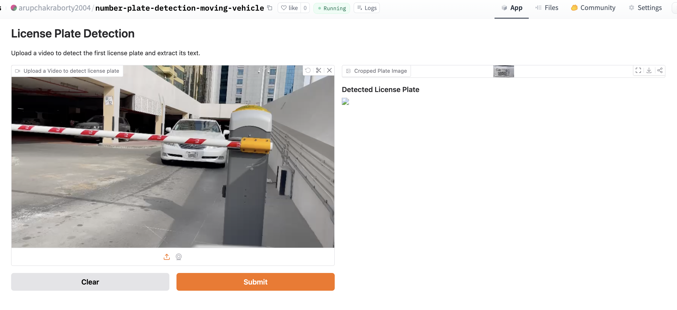
Demo with real-time dataset
https://huggingface.co/spaces/arupchakraborty2004/number-plate-detection-moving-vehicle

Slide 3
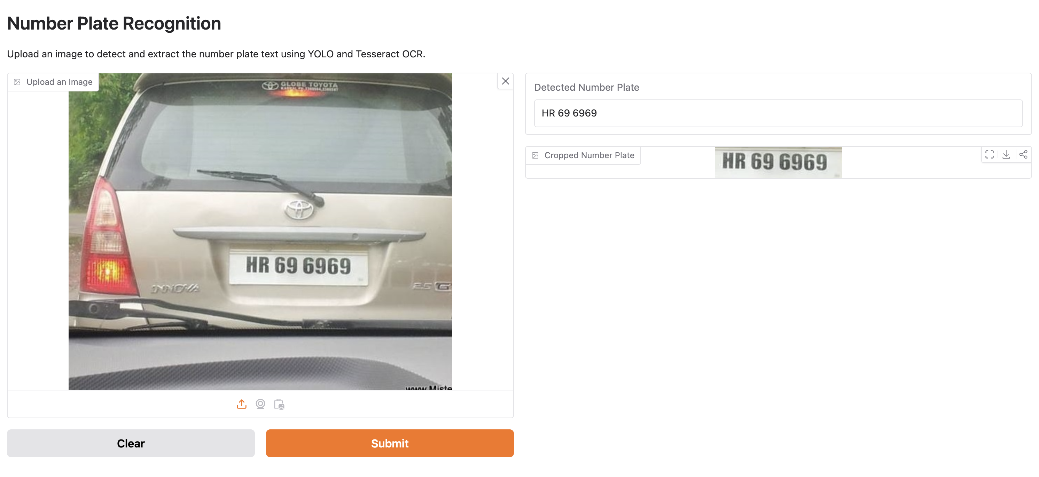
Demo with real-time dataset
https://huggingface.co/spaces/arupchakraborty2004/image-recognition-yolo

Slide 4
Abstract/Overview
Aim:
AI system
Automatically Detect the license plate for vehicles
Goals
Accurate License plate detection
Precise character recognition for license plate
Real-time processing for traffic monitoring, automated toll collection, security surveillances.
Comprehensive evaluation of metrics via Tensorboard

Slide 5
Abstract/Overview
Code attempts to
Reduce detection time for license plates from images and videos
Improve accuracy
Support decision-making for traffic management, law enforcement, automated toll system.
Focus issues
Data quality and augmentation
Model Accuracy
Balancing sensitivity and decision making
Interpretability of results and metrics
Model hosting

Slide 6
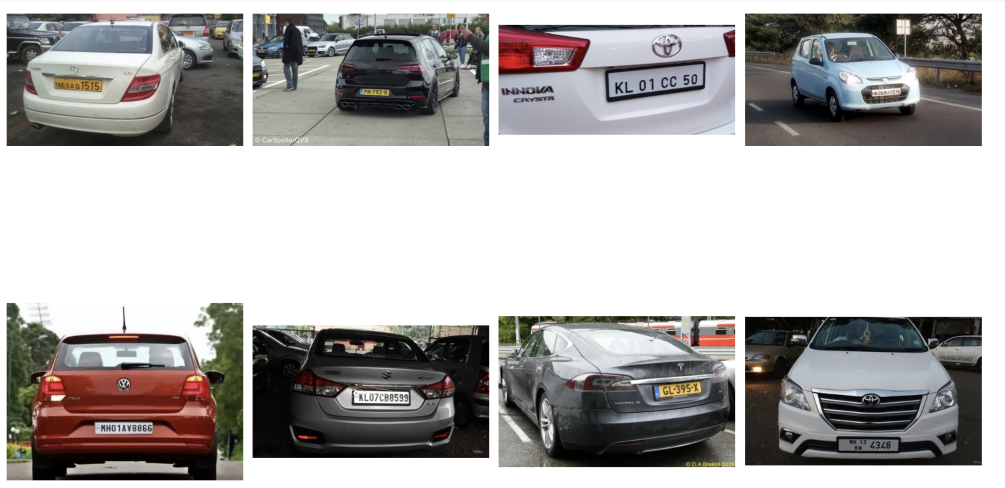
Overview of Dataset
Dataset composition
Images
Annotations
Classes
Variations
Features and attributes

Slide 7
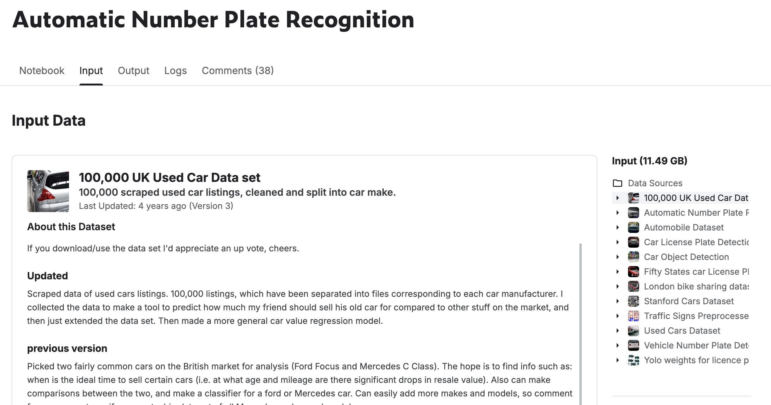

Methods - Creating a Model to Detect License plates
Data Selection
Data Acquisition and Preparation
Data Exploration and Preprocessing
Model Development using YOLO, RESNET
Notes:
Arup starts

Slide 8
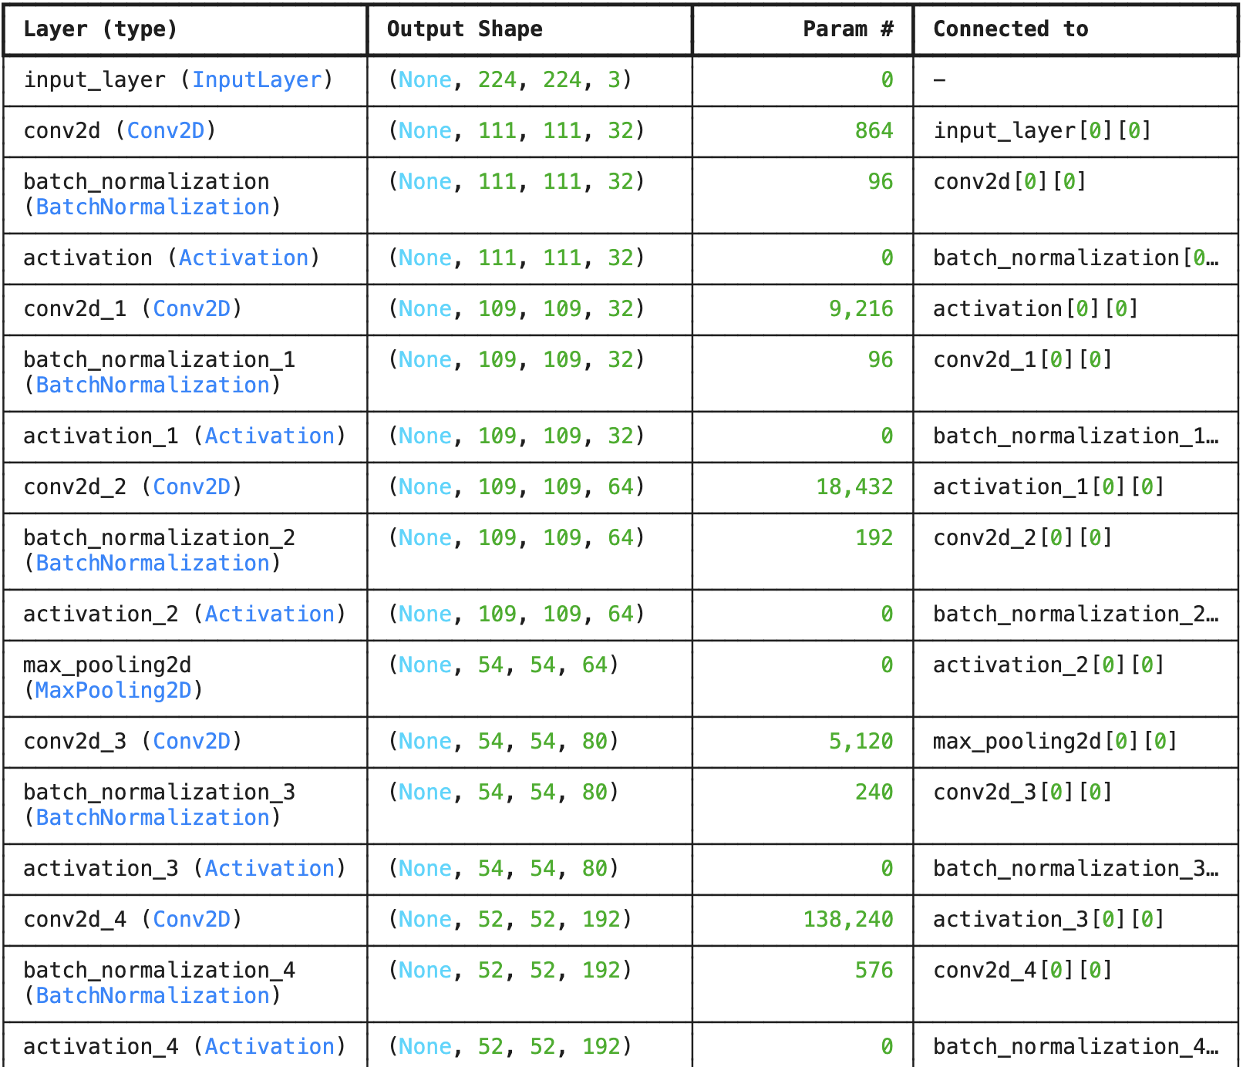
Methods - Training Model and Evaluation
Training and Validation Setup
Model Training and Visualization
Model Architecture and Compilation
Model Performance Evaluation
Model Evaluation Metrics

Slide 9
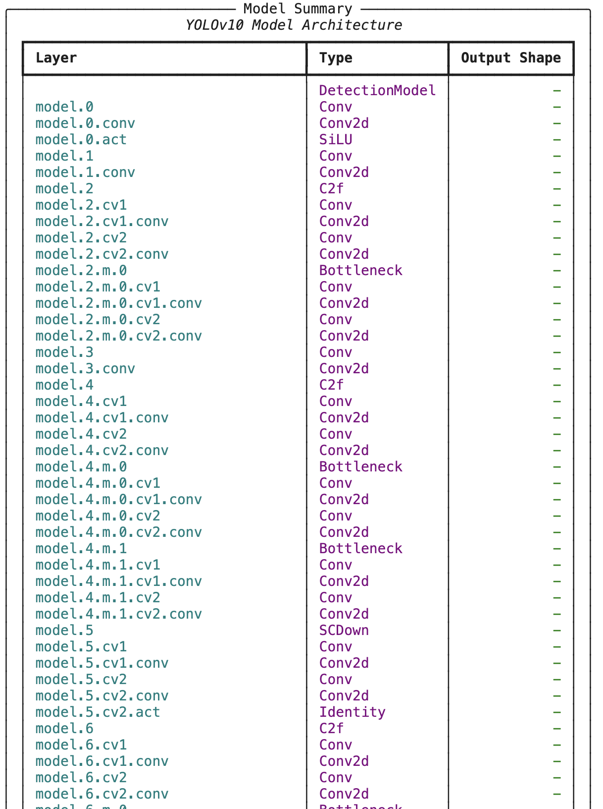
Methods - Training Model and Evaluation
Training and Validation Setup
Model Training and Visualization
Model Architecture and Compilation
Model Performance Evaluation
Model Evaluation Metrics

Slide 10
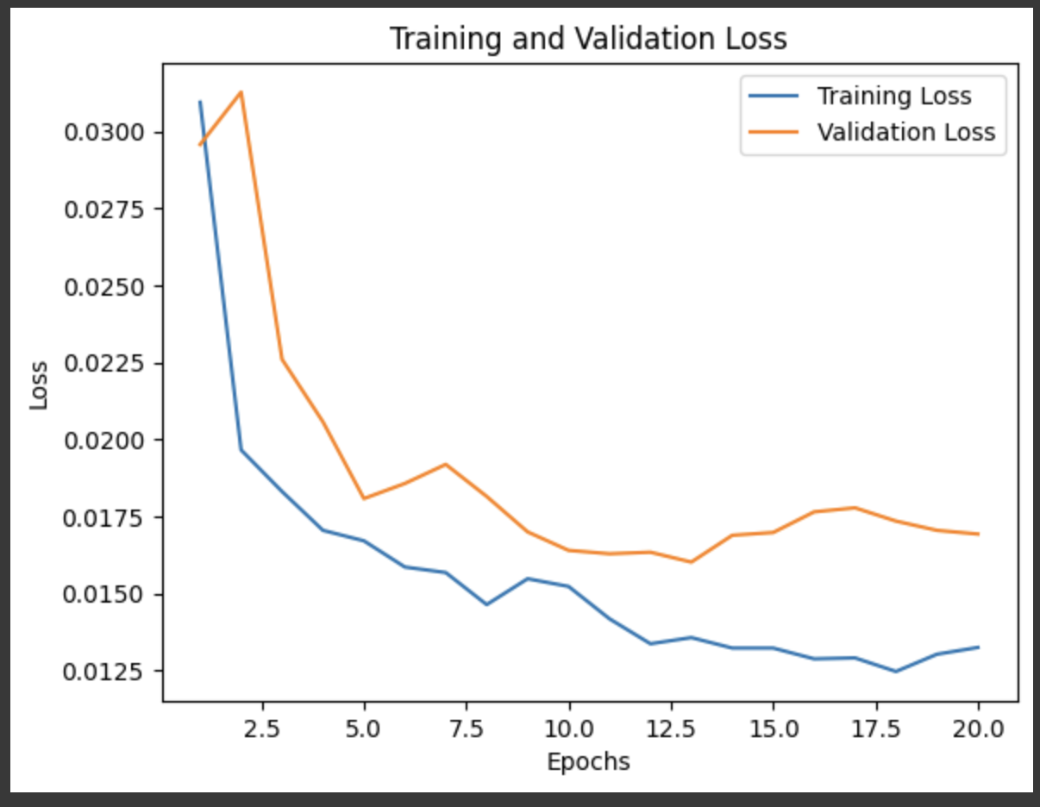
Results/Discussion - Model Performance Evaluation
Model training and validation loss
Model monitoring via Tensorboard
Efficient learning
No overfitting
Transfer learning

Slide 11
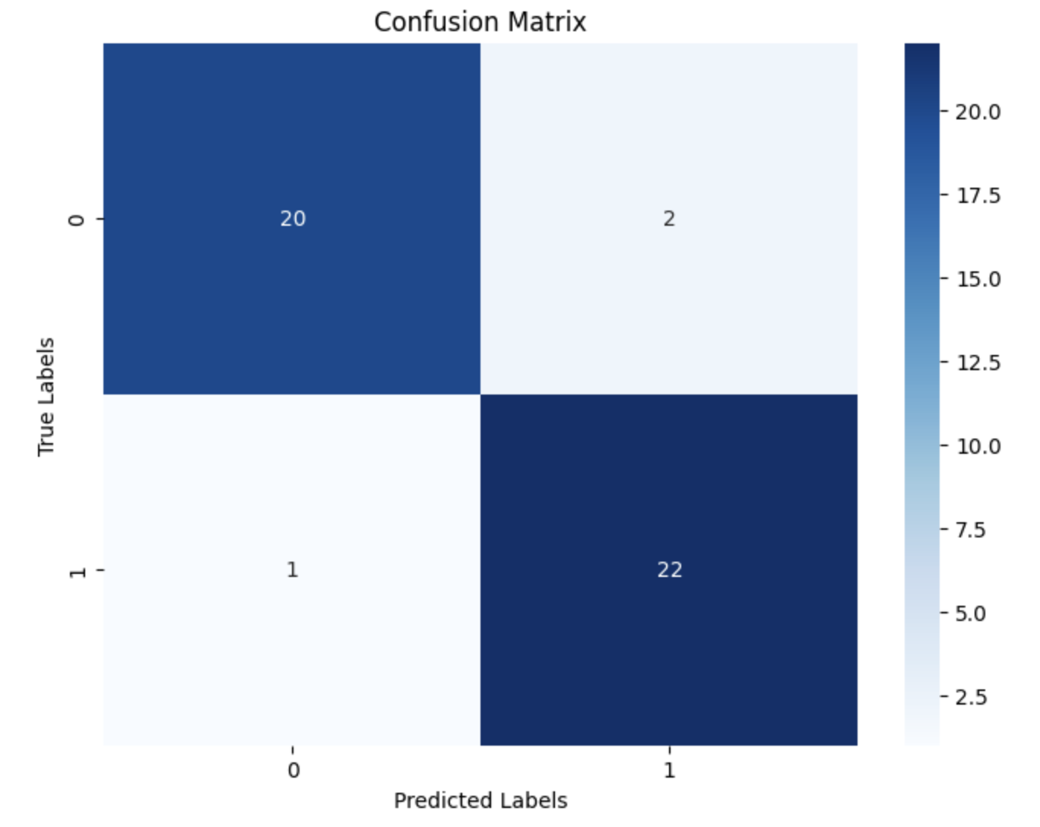
Results/Discussion - Model Evaluation Metrics
Confusion Matrix
Comprehensive insights
Advantages
Disadvantages
Compare with other models

Slide 12
Observations
Model accuracy depends on
Data Quality and Quantity
More data
Data augmentation
Balanced dataset
Model Architecture
Depth of network
Hyperparameter tuning
Regularization Techniques
Dropout
Weight regulation
Notes:
Jory continues: Observations
The accuracy for model predictions depends on quite a few factors:
Data Quality and Quantity
More Data: Generally, more data leads to better model performance.
Data Augmentation: Techniques like rotation, scaling, cropping, and flipping can help the model generalize better by providing a more diverse set of training examples.
Balanced Dataset: We need to prevent the model from becoming biased toward more frequent classes.
Model Architecture
Depth of the Network: Adding more layers can help the model learn more complex patterns, but too many layers might lead to overfitting.
Hyperparameter Tuning: Optimizing hyperparameters, including the number of filters, kernel size, and activation functions, can significantly impact model performance.
Regularization Techniques
Dropout: Randomly dropping units from the neural network during training can prevent overfitting.
Weight Regularization: Adding L1 or L2 regularization to the model weights can also help prevent overfitting by penalizing large weights.

Slide 13
Discussion Continued
Future Enhancements
Advanced YOLO model, like YOLOv11
Multilingual support for internation license plates
Real time scalability
Dataset enhancements
Improved OCR technologies
Enhanced security for detecting fake license plates
Notes:
Jory continues: While the current model showed promising results, future enhancements could include:
Exploring more advanced neural network architectures.
Experimenting with different hyperparameters.
Employing more sophisticated data augmentation techniques to improve model generalization.
MRI images may be streamlined by including edge detection as a preprocessing step, which might increase the model's diagnostic accuracy. The CNN model, especially with transfer learning via the Xception architecture, shows potential for improving diagnostic accuracy in medical imaging, according to a comparison of the generated results with the body of current research.

Slide 14
References
Bochkovskiy, A., Wang, C. Y., & Liao, H. Y. M. (2020). YOLOv4: Optimal speed and accuracy of object detection. arXiv preprint arXiv:2004.10934. Retrieved from https://arxiv.org/abs/2004.10934
Redmon, J., & Farhadi, A. (2018). YOLOv3: An incremental improvement. arXiv preprint arXiv:1804.02767. Retrieved from https://arxiv.org/abs/1804.02767
Tesseract OCR. (2023). Tesseract Open Source OCR Engine. Retrieved from https://github.com/tesseract-ocr/tesseract
Goodfellow, I., Bengio, Y., & Courville, A. (2016). Deep learning. MIT Press.
Ultralytics. (2024). YOLOv8 Documentation. Retrieved from https://docs.ultralytics.com
Kingma, D. P., & Ba, J. (2015). Adam: A method for stochastic optimization. arXiv preprint arXiv:1412.6980. Retrieved from https://arxiv.org/abs/1412.6980
Ronneberger, O., Fischer, P., & Brox, T. (2015). U-Net: Convolutional networks for biomedical image segmentation. In International Conference on Medical Image Computing and Computer-Assisted Intervention (pp. 234–241). Springer, Cham.
Ahmedov, A. (n.d.). Automatic number plate recognition [Kaggle Notebook]. Retrieved from https://www.kaggle.com/code/aslanahmedov/automatic-number-plate-recognition/input

Slide 15
Thank you!
Notes:
On behalf of Team 1, thank you for your time watching our presentation.

